Slide 1
REAL TALK
January 21, 2020
A Candid Conversation about Marijuana and Vaping
​

Slide 2
Welcome-Pastor Peter Sutton

Slide 3
Agenda –January 21, 2020
Welcome-Compass Pastor Peter Sutton
Introductions & Overview-Kamala Martinez CEO KidsMatter
Dr. Aaron Weiner-Director of Addiction Services Linden Oaks
Matt Quinn-Community Relations Rosecrance
Adam Russo- CEO Edgewood Clinical
Detective Rich Wistocki- President Be Sure Consulting
Legalization
Education
Health & Safety
Resilient Coping Skills
Resources
Q & A
Close –Good Shepherd Pastor Ryan Schaible

Slide 4
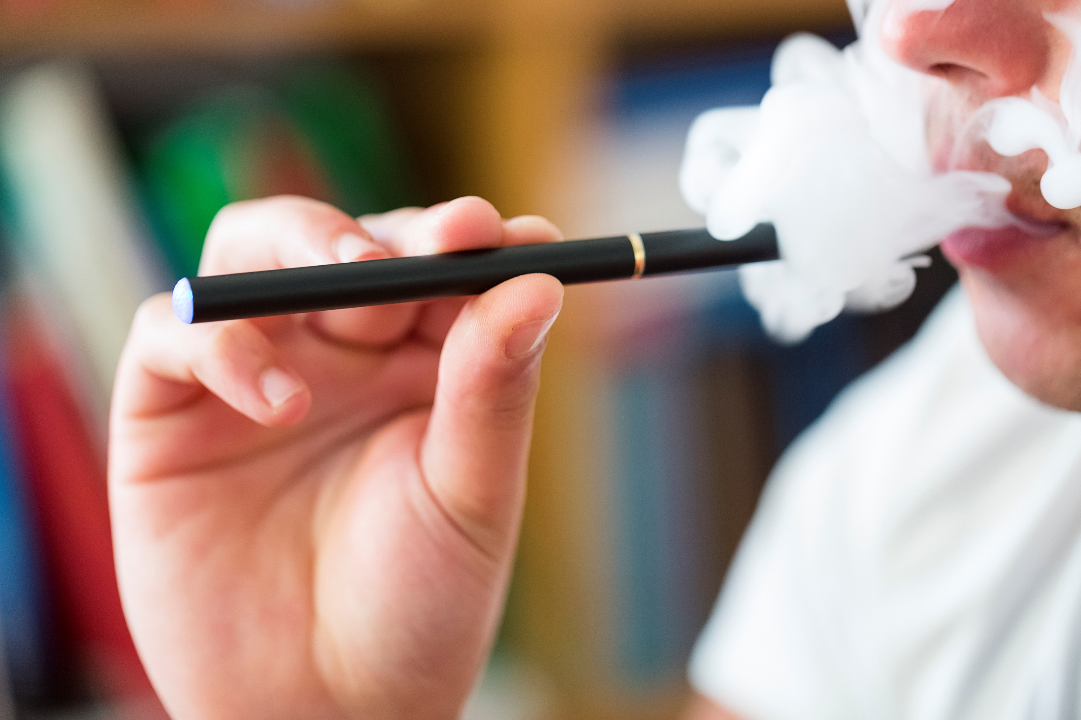
The Truth About Legal Weed

Slide 5
What Does The Law Say About Cannabis Now?

Slide 6
My Background
BA in Psychology from University of Notre Dame
MA in Clinical Psychology from Illinois School of Professional Psychology
Licensed Clinical Professional Counselor (LCPC) and Certified Alcohol and Drug Counselor (CADC)
15 years working with teens/young adults and their families
6 years in private practice in Lombard
4 years in community relations for Rosecrance Health Network
8 years leading teen substance abuse program at Elmhurst/Edward Hospital

Slide 7
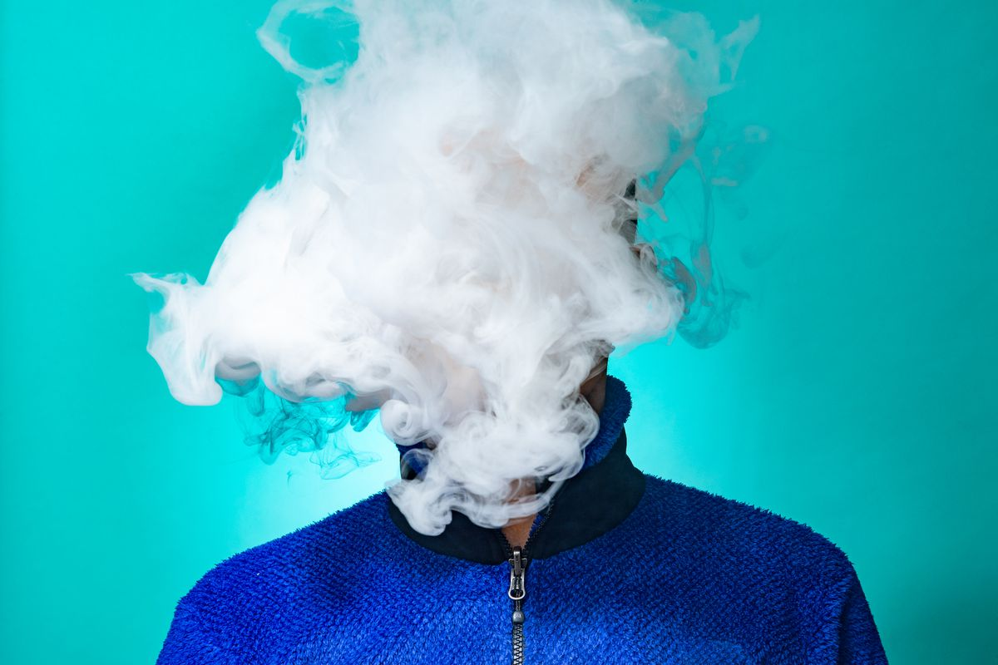
A Guide to the Today’s Marijuana and Vaping Matthew Quinn, LCPC, CADC

Slide 8
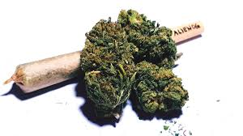
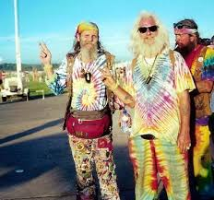
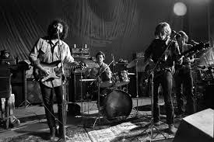

Slide 9
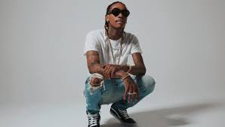
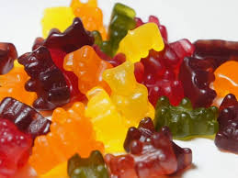
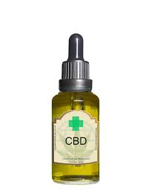
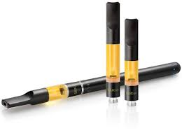

Slide 12
Higher Dose Effects of THC
Difficulty thinking/making decisions/solving problems
Distorted perceptions
Impaired balance and coordination
Paranoia
Problems with Learning/Memory
Acute Psychosis (Delusions, Panic)

Slide 13
Great risk from… | 1991 | 2006 | 2018
Try marijuana once or twice | 30% | 22% | 14%
Use marijuana occasionally | 49% | 36% | 21%
Use marijuana regularly | 82% | 67% | 38%

Slide 14
Risk for Progression

Slide 15
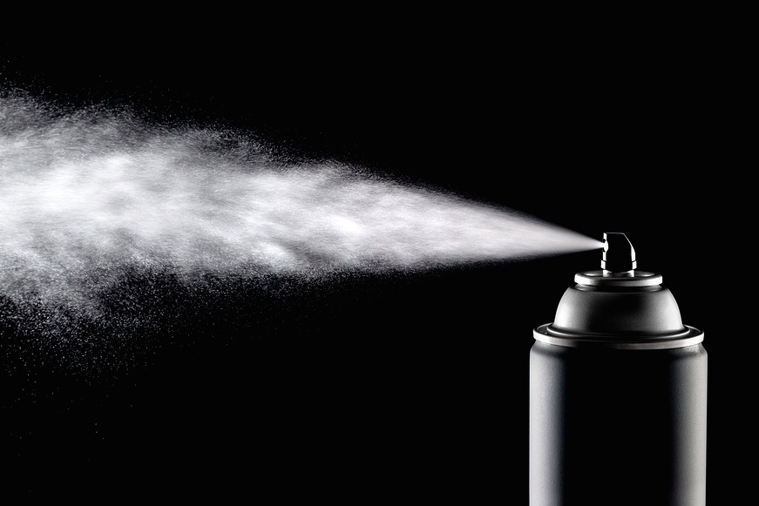

Slide 16
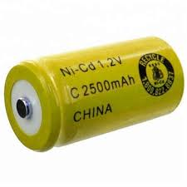

Slide 17
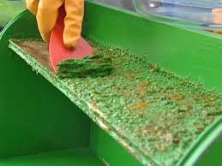

Slide 18
Acetaldehyde (paint stripper)
Acetone
Acrolein
Benzene (pest and gas)
Cadmium (car batteries)
Chromium
Diacetyl (popcorn lung)
Diethylene Glycol (afreeze)
Formaldehyde
Isoprene (rubber)
Lead
Nickel
Proponal
Propylene Glycol (deicing)
Tin
Toluene (poison industrial solvent

Slide 19
Vaping Recently Linked with Deaths and Lung Damage
60 vaping related deaths
Over 2,600 diagnosed with breathing-related illnesses
Vitamin E acetate (lung fluid from 29 cases in 10 states)
Chemical burns from pesticides/fungicides (hydrogen cyanide)

Slide 21
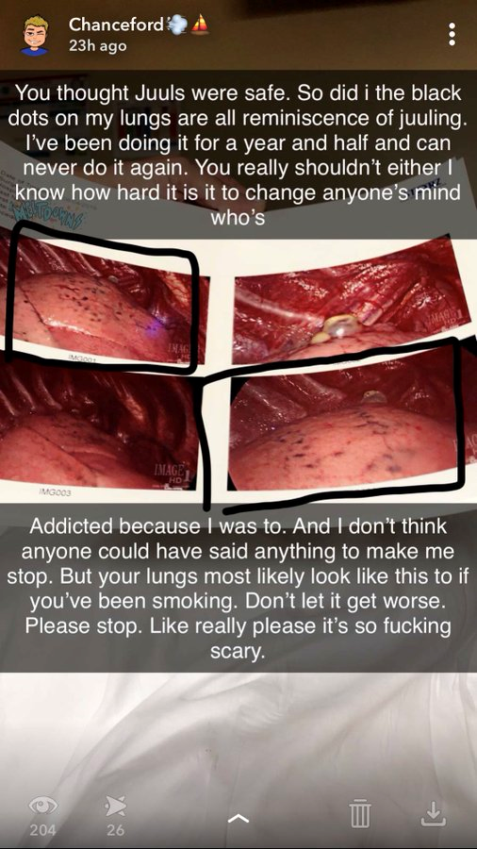

Slide 22
Your Brain on Juul
First-time users becoming addicted in two months vs. two years
Urine level of nicotine 60% higher than cigarettes
58% of Juul users kept using after trying vs. 17% for cigarettes
“It’s hard to sum up,” 17 year old said. “It’s something that’s made my life worse, made my life terrible. I wish I had never started it.”

Slide 23
Sources
https://e-cigarettes.surgeongeneral.gov/documents/2016_sgr_full_report_non-508.pdf
https://www.fda.gov/TobaccoProducts/GuidanceComplianceRegulatoryInformation/Manufacturing/ucm602792.htm#9
https://www.hsph.harvard.edu/news/press-releases/e-cigarette-flavoring-chemicals-linked-to-respiratory-disease/
http://newscenter.lbl.gov/2016/07/27/e-cigarettes-emit-harmful-chemicals-emit-others/
https://phys.org/news/2017-04-quantitative-aldehyde-content-electronic-cigarettes.html
https://www.sciencenewsforstudents.org/article/e-cigs-create-toxic-vapors-harmless-e-liquids
https://www.reuters.com/investigates/special-report/juul-ecigarette/https://www.webmd.com/smoking-cessation/news/20150218/e-cigarette-ingredients#1
http://gaspforair.org/gasp/gedc/pdf/E-CigSmoke.pdf

Slide 24
Thank You!!
Matthew Quinn, LCPC, CADC
630-779-6819
mjquinn520@gmail.com

Slide 25
Dr. Aaron Weiner, PhD, ABPP
Licensed Clinical Psychologist
Board-certified in Counseling Psychology
Master Addiction Counselor (MAC)
Director of Addiction Services at Linden Oaks Behavioral Health
Former Board Representative for the Society of Addiction Psychology
Science Advisory Board for Smart Approaches to Marijuana

Slide 26
Cannabis – A Particularly Bad Idea for Kids
Increased risk for addiction

Slide 27
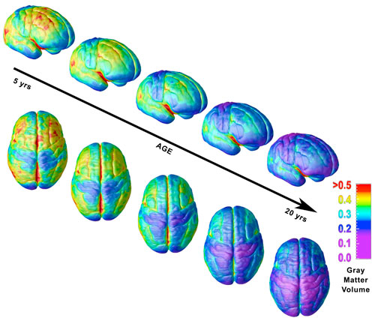
Notes:
Prefrontal cortex is one of the last part to develop. Decision-making center, planning, abstract thought.

Slide 28
Cannabis – A Particularly Bad Idea for Kids
Increased risk for addiction
This isn’t Woodstock pot anymore – much stronger
Negative academic and vocational outcomes

Slide 29
Academic and Vocational Outcomes
High School
Lower grades, higher dropout rates, increased school disciplinary problems
May be social/functional, may be cognitive, may be both
Earlier use = worse outcomes
Greater frequency = worse outcomes
College
Increased chance to skip class
Lower GPA
Potentially longer time to graduate
Decreased lifetime earning potential

Slide 30
Cannabis – A Particularly Bad Idea for Kids
Increased risk for addiction
This isn’t Woodstock pot anymore – much stronger
Negative academic and vocational outcomes
Brain morphology changes
Residual impairment in memory, processing speed, and decision-making

Slide 31
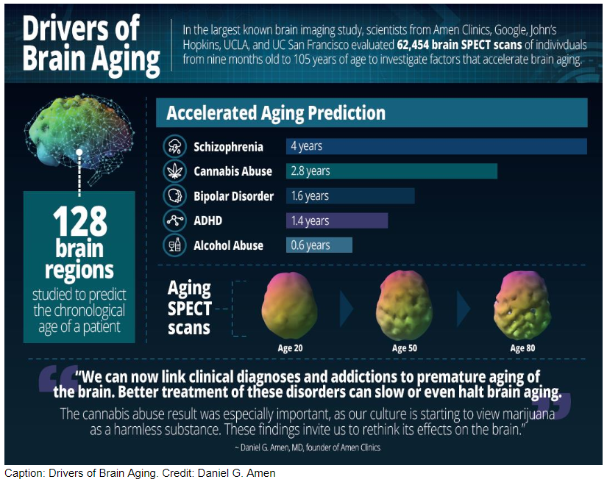

Slide 32
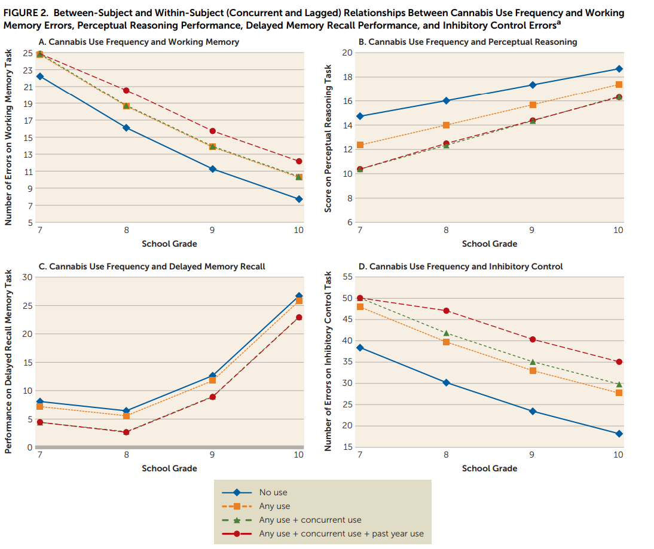

Slide 33
Cannabis – A Particularly Bad Idea for Kids
Increased risk for addiction
This isn’t Woodstock pot anymore – much stronger
Negative academic and vocational outcomes
Brain morphology changes
Residual impairment in memory, processing speed, and decision-making
Impaired judgement
Increased risky sexual behavior
Psychotic breaks
Increases with higher % THC

Slide 34
Notes:
Has significant and permanent ramifications on adolescent brain development
8 IQ points, anatomy, lifetime earning potential
Regular use linked to development of psychotic disorders

Slide 35
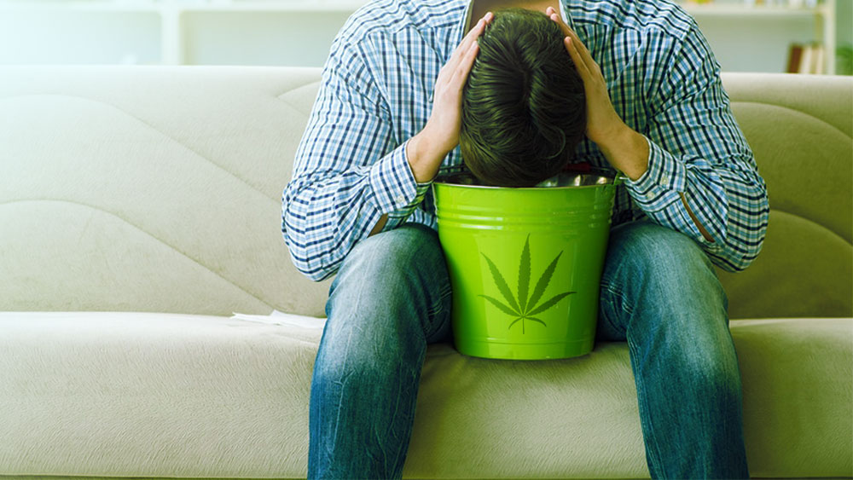

Slide 36
Cannabis – A Particularly Bad Idea for Kids
Increased risk for addiction
This isn’t Woodstock pot anymore – much stronger
Negative academic and vocational outcomes
Brain morphology changes
Residual impairment in memory, processing speed, and decision-making
Impaired judgement
Increased risky sexual behavior
Psychotic breaks
Increases with higher % THC
Drugged driving

Slide 38
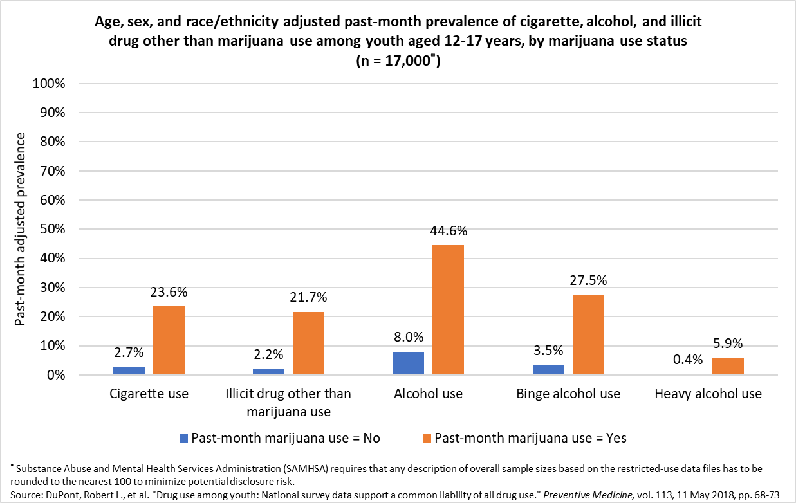
Gateway Drug?
Notes:
Clearly. Not everyone does it, but the risk is elevated.

Slide 39
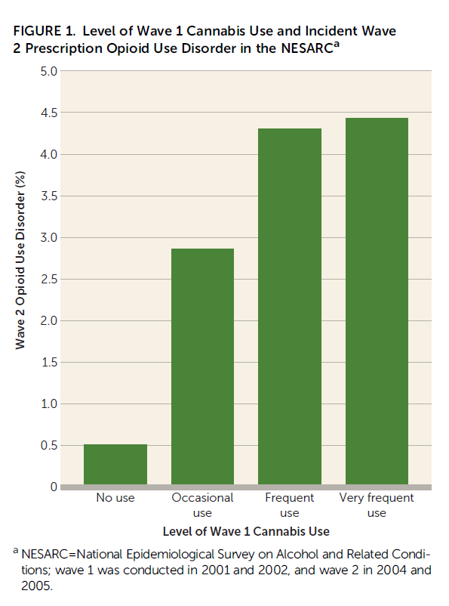

Slide 40
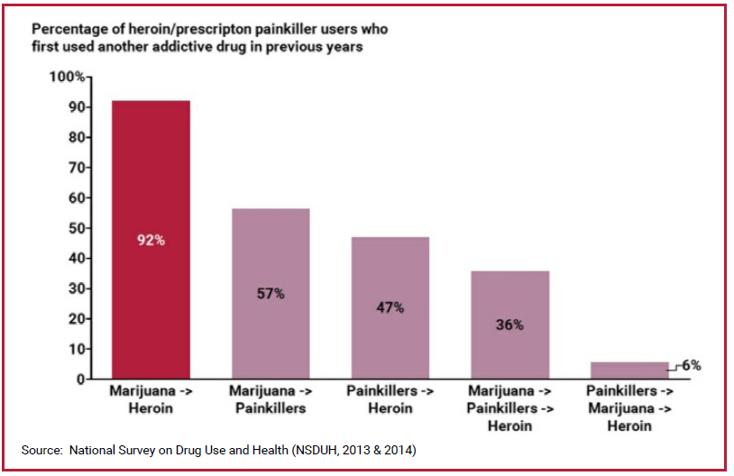

Slide 41
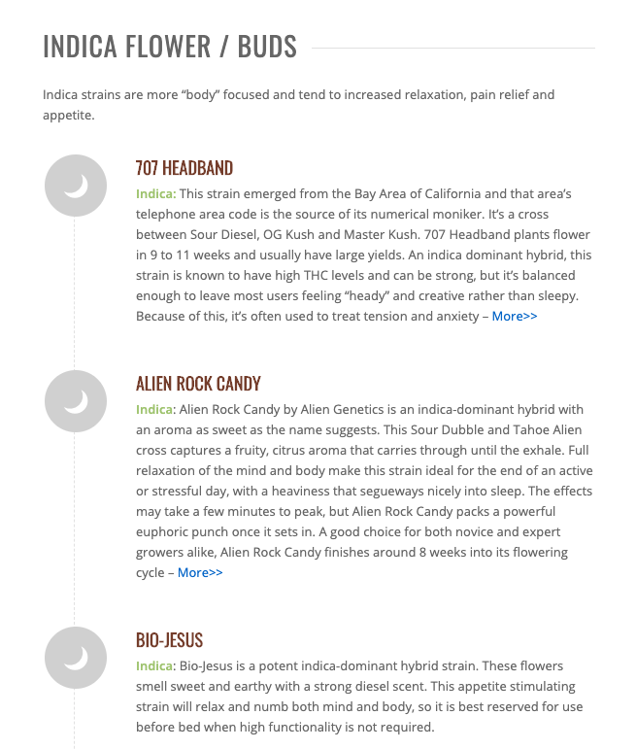
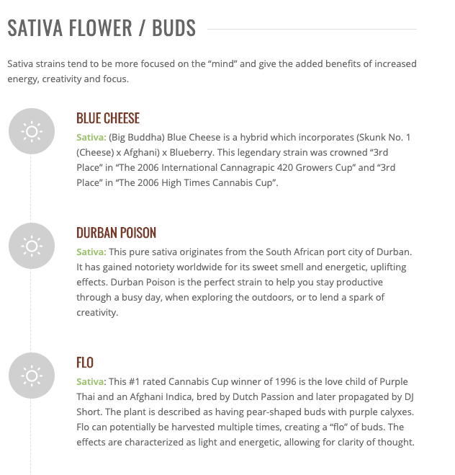
Marketing – It’s Always on Purpose

Slide 42
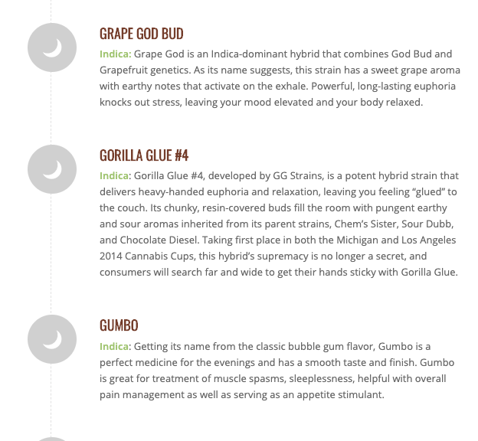
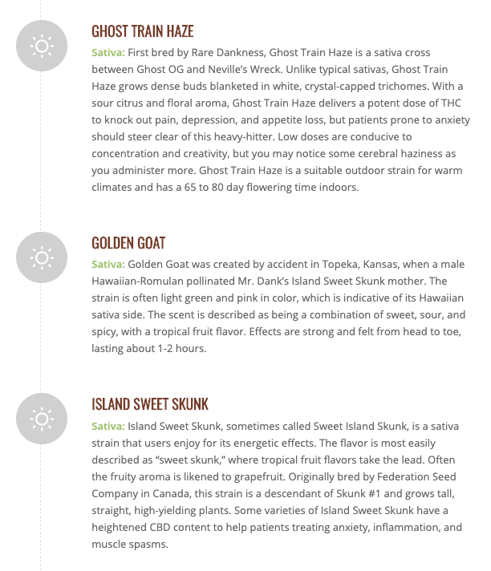

Slide 43
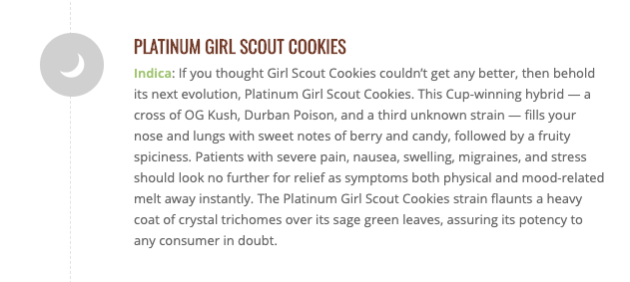
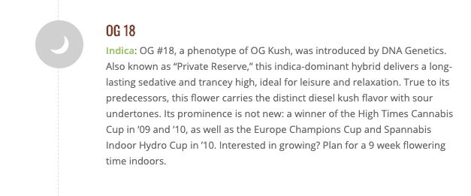

Slide 44
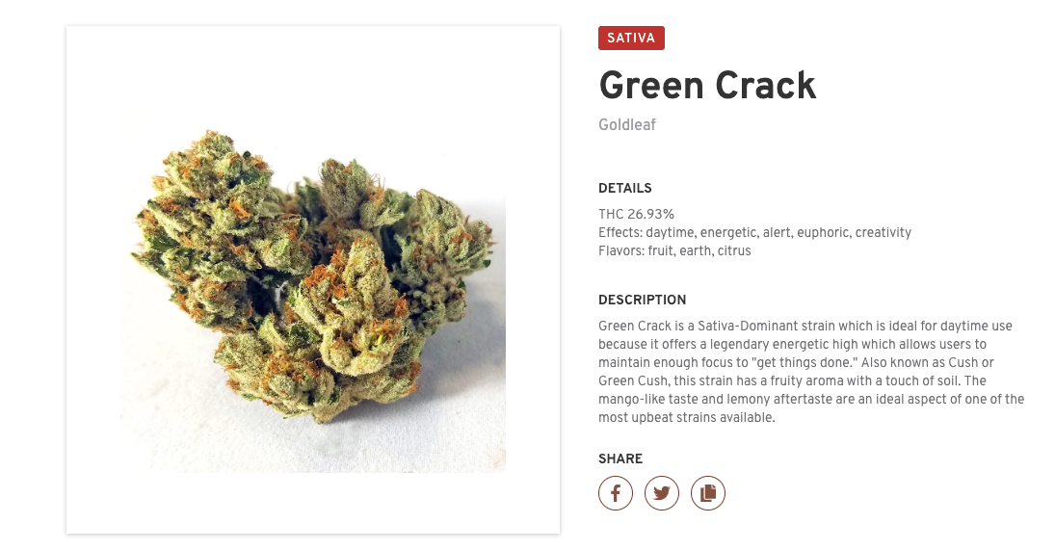

Slide 47
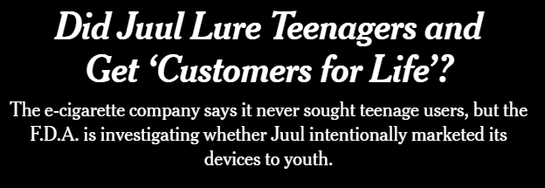

Slide 50
Summary
Vaping and marijuana are both chronically misunderstood…and this isn’t an accident
From a health perspective, nobody should vape if they aren’t already smoking cigarettes…and particularly not kids
Marijuana is far from a benign substance, and is particularly harmful for youth
Marijuana and THC extracts can be vaped, and higher potency is associated with more severe side effects

Slide 51
Building
Resilience
Presented By
Adam Russo, LCSW
Notes:
Industrial to Information age -

Slide 52
Coping with Anxiety
What is the
Purpose of Parenting?
Notes:
Parenting short term vs. long term

Slide 53
Coping with Anxiety
Delayed Gratification
is Essential to Success
Notes:
College Acceptance - combination lock
Looking for ‘instant’ success in life
Who defines your success? You? Parents? Significant other?
GW - former NCHS student

Slide 54
Skills for Success
Anxiety is not bad
Anxiety can and should be helpful
Coping with Anxiety is an adaptive skill
Notes:
Culture is in 'Anxiety Prevention Mode’
‘Who lives a stress-free life?’
Wrestling with making a decision - anxiety about consequence should drive decision

Slide 55
Correlates to Success
Adaptability
Notes:
6.7x more likely to be high performing when adaptable
Experiences in new or unfamiliar roles that broaden experience or require leadership during a crisis are two hallmarks of successful CEOs found in research
Adaptable CEOs understand that setbacks are an integral part of changing course and opportunities to learn and grow.
Nearly 90% of strong CEO candidates scored highly on dealing with setbacks

Slide 56
Correlates to Success
Velocity
of
Decision Making
Notes:
12x more likely to be high performing when described as ‘decisive’
CEOs with higher IQ struggle as bogged down in analytics
Teach kids to play poker - Maria Konnikova - remove strong emotions from decisions
Maximizing vs. satisficing
Less subjective happiness maximizing
Nobel prize winner Herbert Simon said “said that in the end, when you calculate all factors of stress, results, and effort, satisficing is actually the method that maximizes.”

Slide 57
Correlates to Success
Reliability
Notes:
15x more likely to be high performing
Pillars: personal consistency, setting realistic expectations, practicing radical personal accountability, and embedding consistency in organization
Reliability trumps exceptionalism - Boards likely to hire someone reliable than a mercurial genius -

Slide 58
Success
Conscientiousness
Notes:
High in Conscientiousness do well when there are clear answers and a clear path. Research shows when they are unemployed, happiness levels drop 120% more than those less conscientious. Without a path, they’re lost.

Slide 59
Success
Challenges
Notes:
Research says we do what’s easiest over what makes us happy. Novel challenges in our lives create engagement.
Difficult but not impossible situations, pessimism kills grit.
Pillsbury case example

Slide 60
College & Education
Researcher Jean Twenge explained:
“American culture has increasingly emphasized high expectations and following your dreams—things that feel good when you’re young. However, the average mature adult has realized that their dreams might not be fulfilled, and less happiness is the inevitable result. Mature adults in previous eras might not have expected so much, but expectations are now so high they can’t be met.”
Notes:
Study - Roy Baumeister at Florida State found that people who committed suicide weren’t in the worst circumstances, but they had fallen short of the expectations they had of themselves.

Slide 61
Conclusion
Stress and Anxiety are a part of life

Slide 62
Conclusion
Kids are best served by exposure to these emotions, not shielded from them

Slide 63
Conclusion
Success is not determined by test scores or college attended.
Determined by motivation,initiative, decision making, and adaptability.

Slide 64
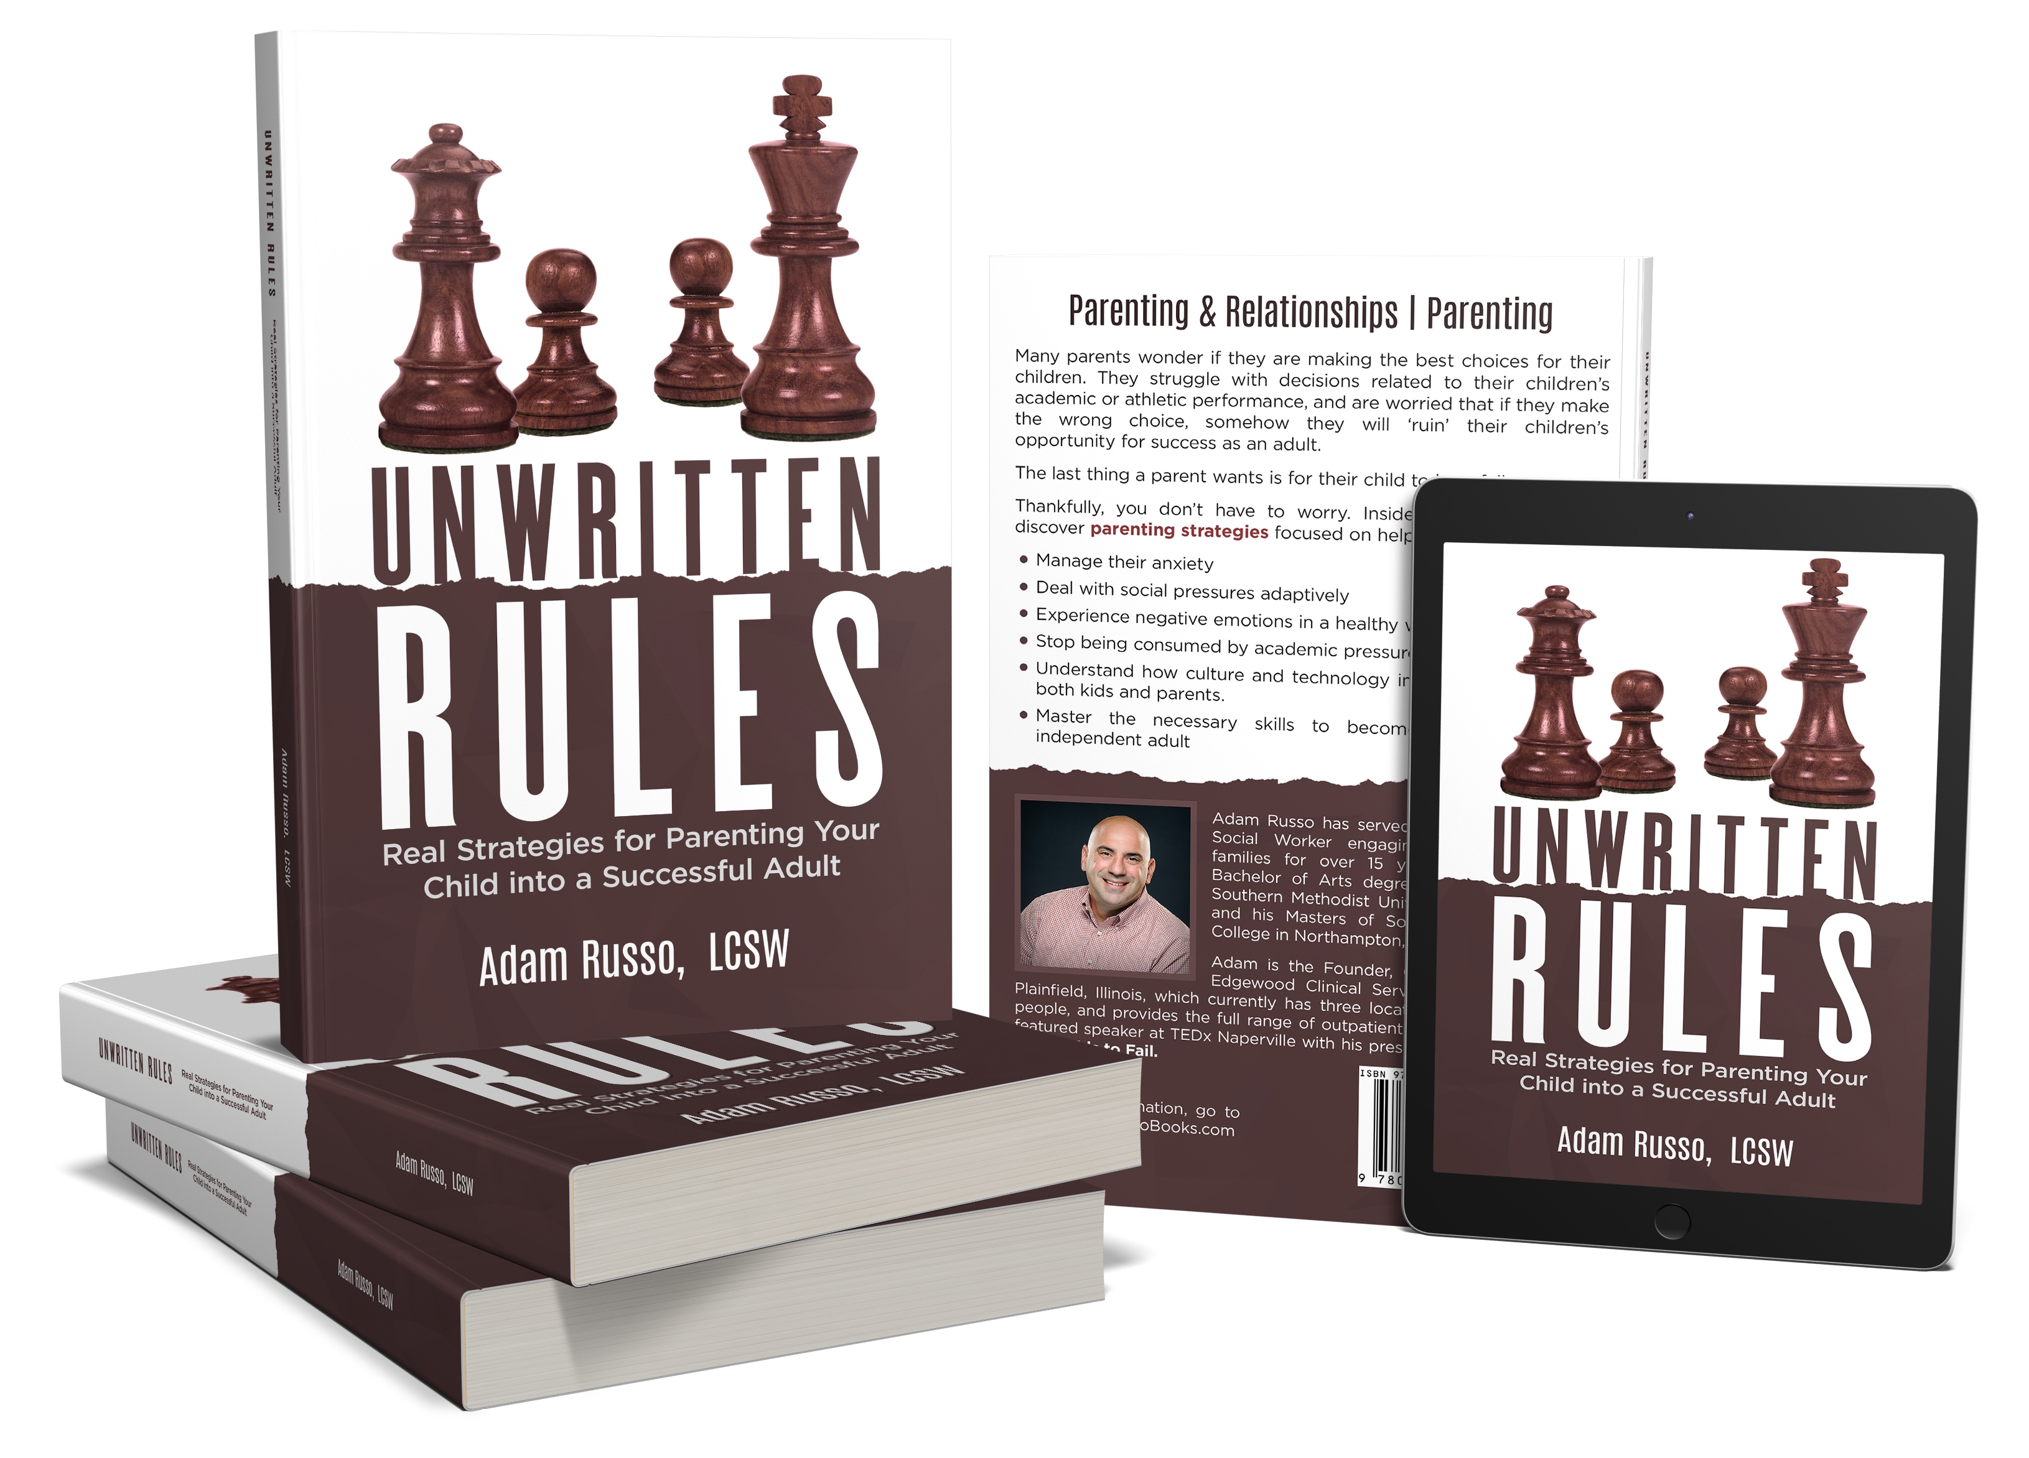
Questions
and
Discussion

Slide 65
How Do I Know If My Child Is Using Drugs?

Slide 66
Biography
Detective 30 Years of Service (RET.)
Naperville IL Police Department
High Technology Crimes Unit
SWAT Sniper 22 Years
Internet Crimes Against Children Task Force (ICAC)
United States Secret Service Chicago Electronic Crimes Task Force
Authored The Illinois Sexting, Cyber-Bullying, and Swatting Laws

Slide 67
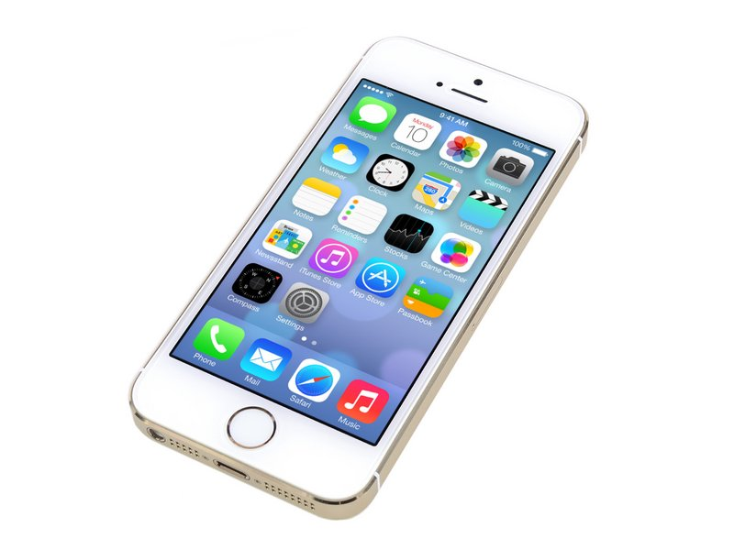
How Do I Know If My Child Is Using Drugs?
It’s All In Here

Slide 68
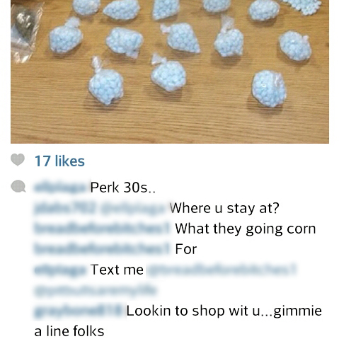
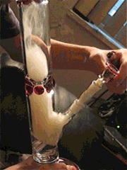
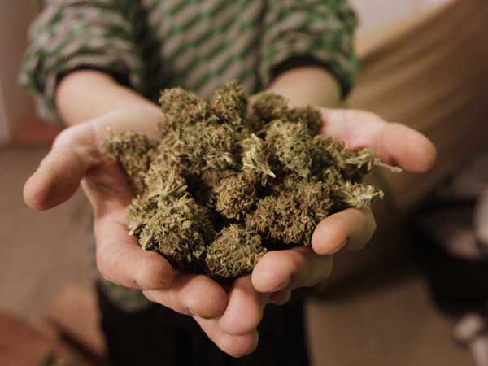
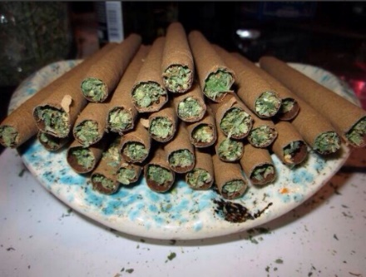
What does doing drugs have to do with Social Media?
EVERYTHING!!!!

Slide 69
If you can monitor their Social Networks,
you will know:
Who they hang out with
Where they are going
Who are they dating
What parties they are going to
What Alcohol/Drugs/Sexual Conduct they are into (If any)

Slide 70
What is the Darknet?
This is a place where your teen can order drugs through an anonymous web browser.
This Browser is called the TOR
Our children can purchase any drug they want.
It will be delivered to them through the US Mail.
The only way to detect this is if you monitor their computers.

Slide 71
It Can Happen Anywhere!

Slide 72
What Can Be Purchased?

Slide 73
Free Apps to Hide Pics/Vids
Go to your App Store or
Google Play and search:
Hide my pictures or Hide my videos

Slide 74
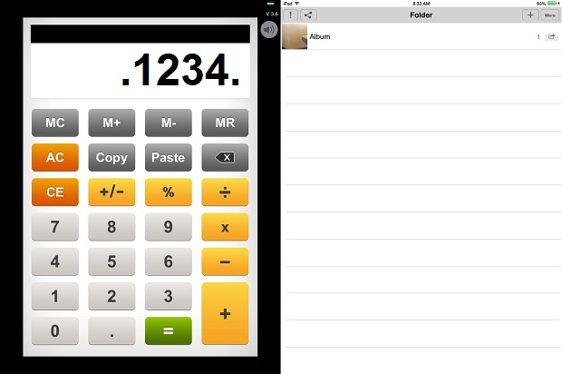
The Calculator Application How does it work?

Slide 75
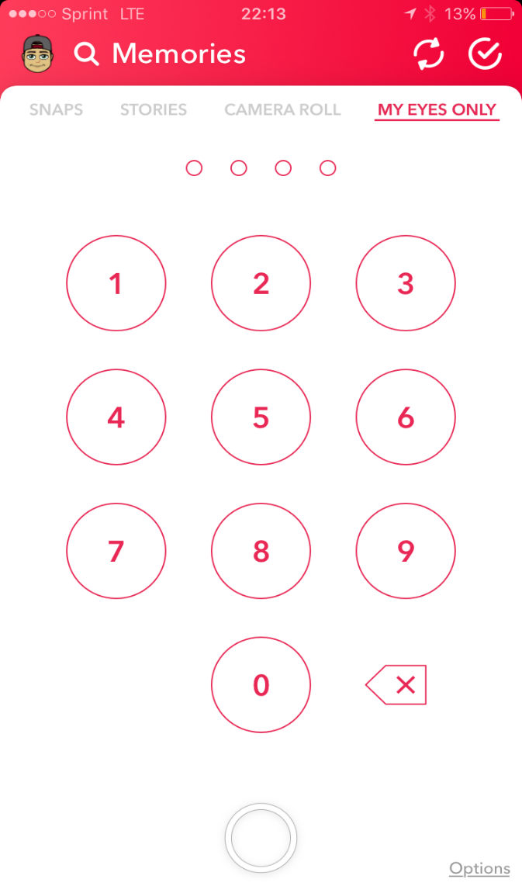
Snap Chat Allows Our Kids TO Hide Their Pics And Vids In A Built In Vault

Slide 76
But I Follow My Kid’s Instagram…

Slide 77
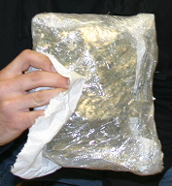
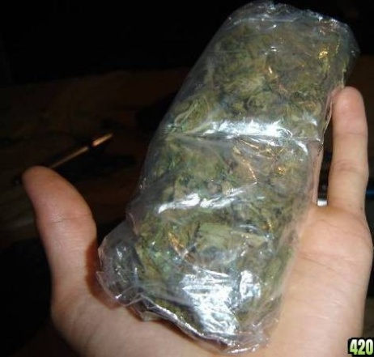
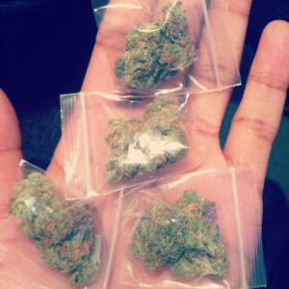
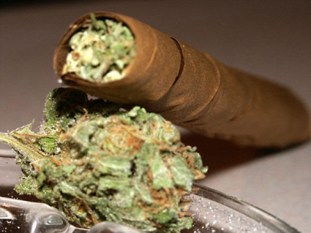
WHAT DOES CANNABIS/POT LOOK LIKE?
Pound
Ounce
Grams
“Blunt”

Slide 78
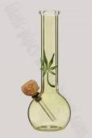
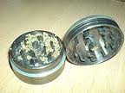
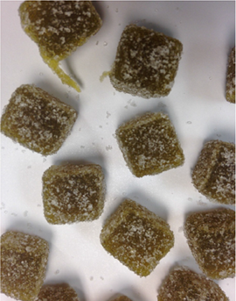
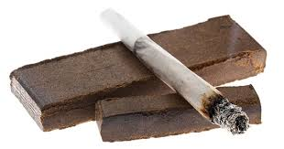
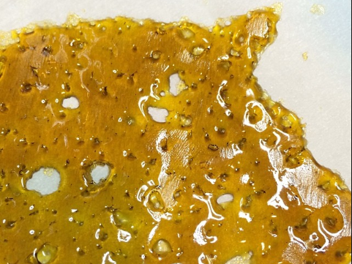
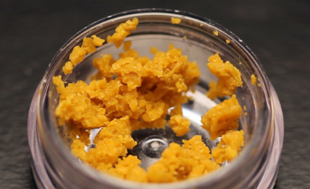
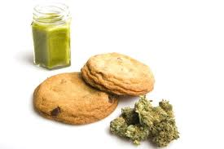
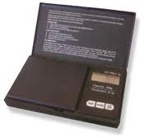
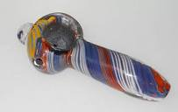
What are some things you may find in their room?

Slide 79
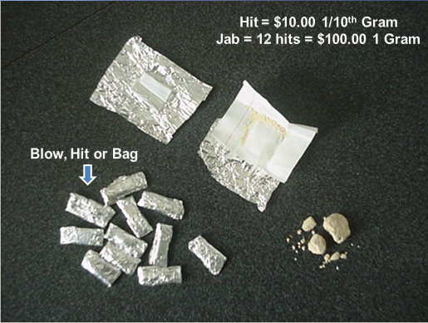
What does Heroin Look Like? What Are The Things You May Find?
Foil Packets/White Substance Syringes/Missing Spoons Cut Up Straws
Foil Balls Rolled Up Dollar Bills Xanax Bars

Slide 80
As a Parent, what am I looking for?
What Am I Looking For?
Warning signs !!!
loss of interest in family activities
disrespect for family rules and values
withdrawal from responsibilities
verbally or physically abusive
sudden increase or decrease in appetite
disappearance of valuable items or money
not coming home on time
not telling you where they are going
constant excuses for behavior
spending a lot of time in their rooms
lies about activities
finding the following: cigarette rolling papers, pipes, roach clips, small glass vials, plastic baggies, remnants of drugs (seeds, etc.)
Is there money missing in small amounts that you knew you had?

Slide 81
What is the answer
to this Problem?
Drug Testing Your Child.

Slide 82
How do I ask my teen to take a drug test?
Let your teens know that you love them too much to let them be involved with drugs.
Assure them you will use any tool available to keep them away from drugs,
This is a very effective means of helping to prevent teen drug use, especially by giving kids a great "excuse" to say, "NO THANKS, MY PARENTS DRUG TEST ME".
If you are reacting to the warning signs and in your gut you know something is going on, be prepared for the
“Truth Serum”

Slide 83
How Do I Monitor My Child’s Cell Phone and Social Networks?
For Android
For Android and Apple Devices
2018/2019 Copyright Be Sure Consulting Inc.

Slide 84
Recap What Did We Learn Tonight?
Legalization
Educational
Health and Safety
Coping Skills
Resources

Slide 85
Close-Pastor Ryan Schaible

